Slide 1
Iteration 3 Rental Car Management (RCM)
Team Rocket (Team 6)
Alisa Belousova, Cangqing (Kris) Wang, Chenghao (Steven) Ye, Devon Dudley, and Nickolas Cruz

Slide 2
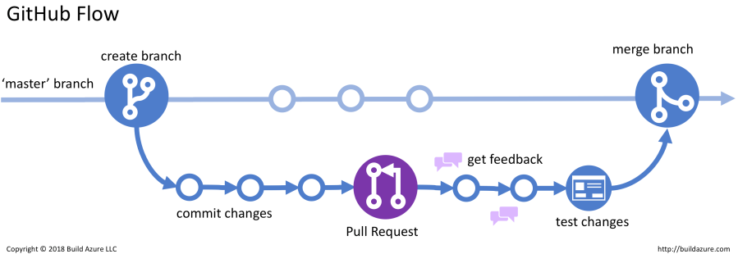
Development workflow: Github flow
Notes:
Github was set up to deploy to Vercel. Every pull request enforces successful deployment and good coding practices

Slide 3
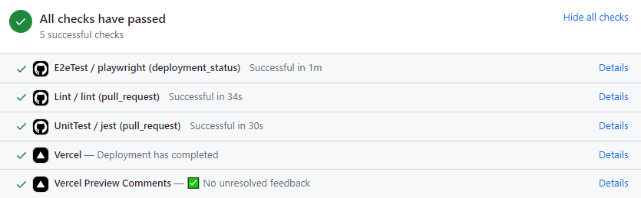
Code quality
Notes:
Github was set up to deploy to Vercel. Every pull request enforces successful deployment and good coding practices

Slide 4
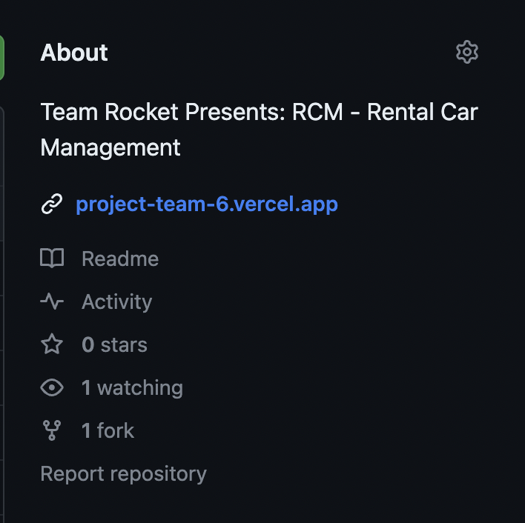
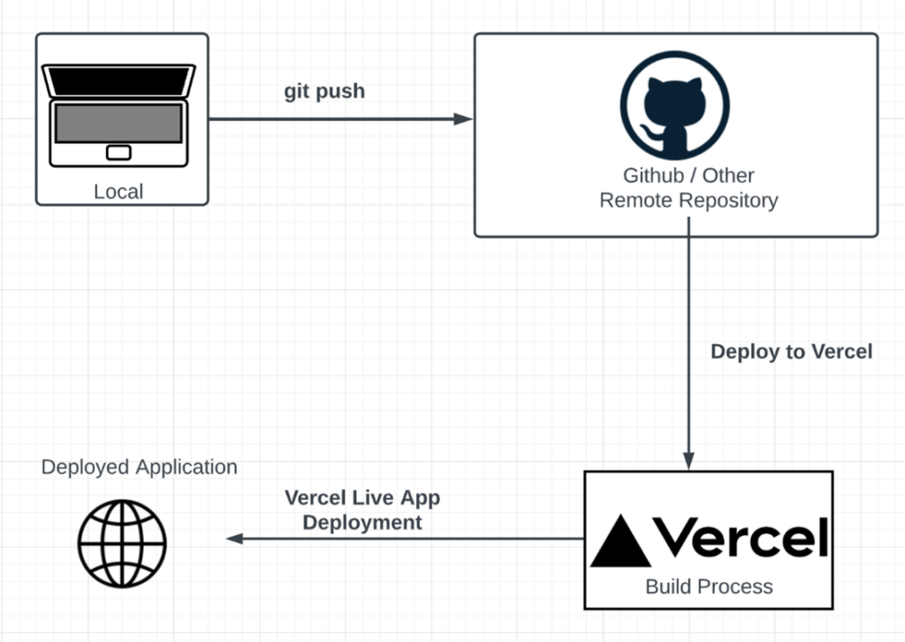
Deployment
Notes:
Github was set up to deploy to Vercel. Every pull request enforces successful deployment and good coding practices

Slide 5

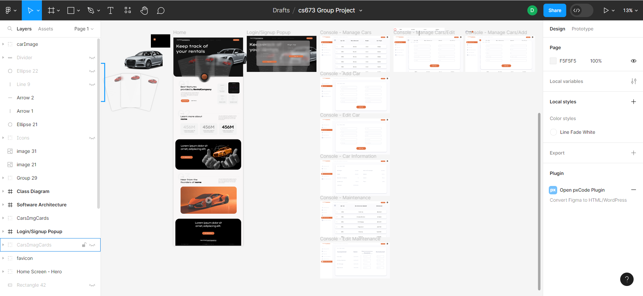
UI Design

Slide 6

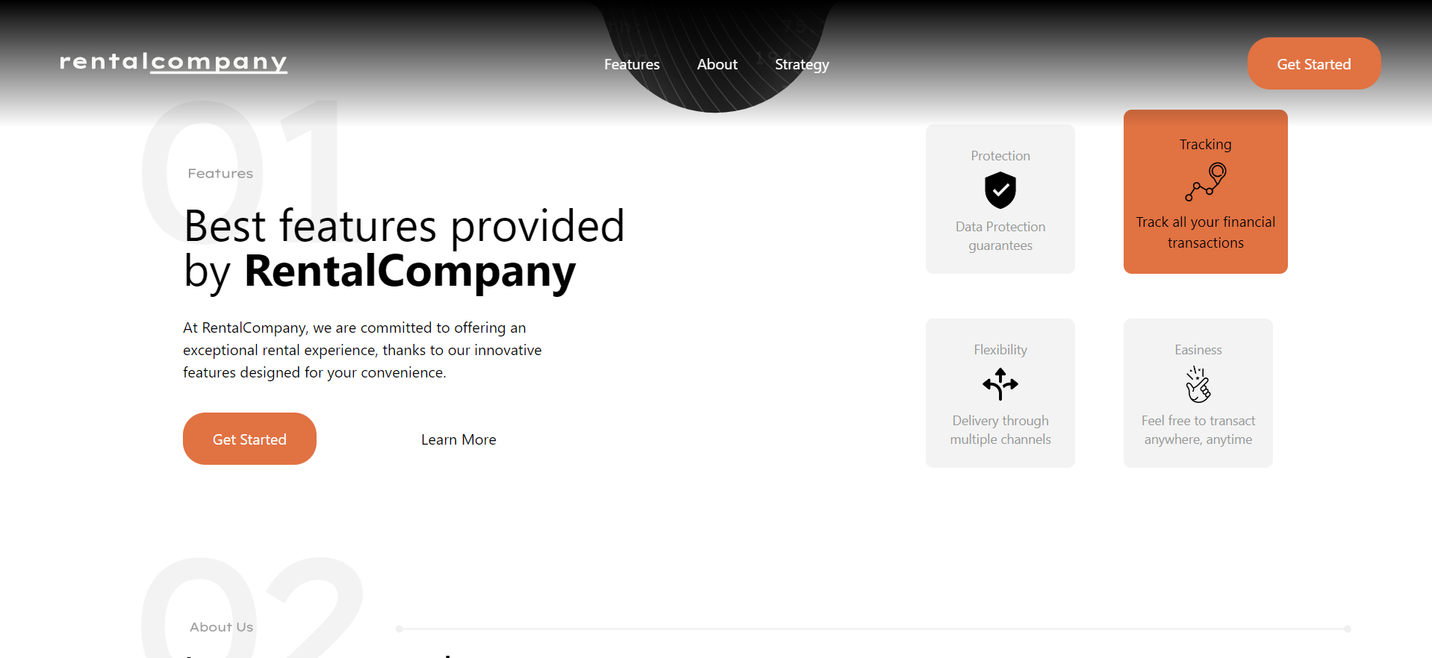



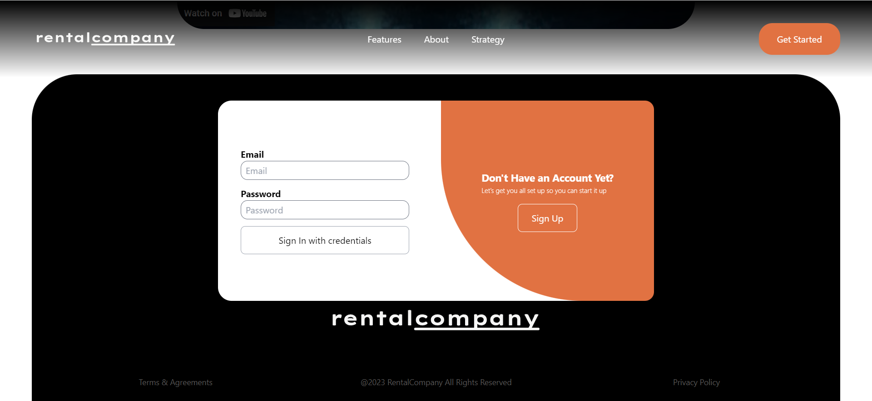
Home Screen

Slide 7
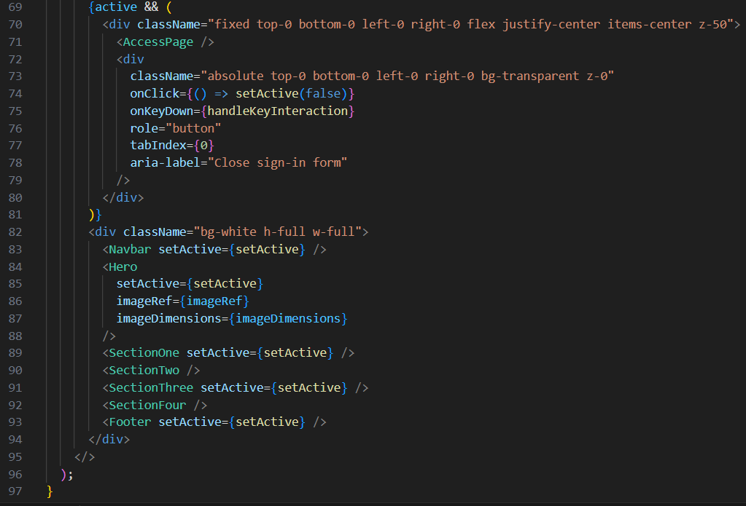
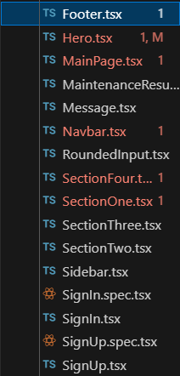

Slide 8
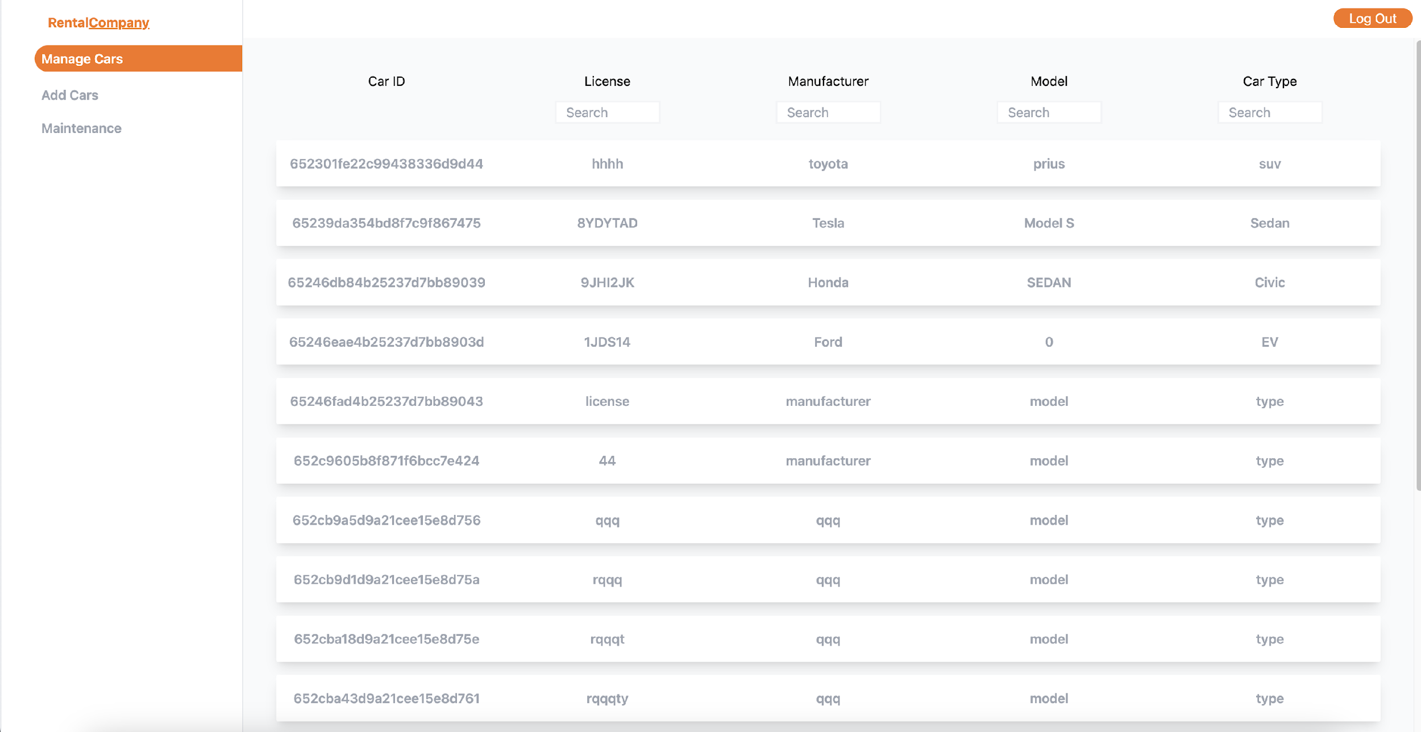
Console Management Page

Slide 9
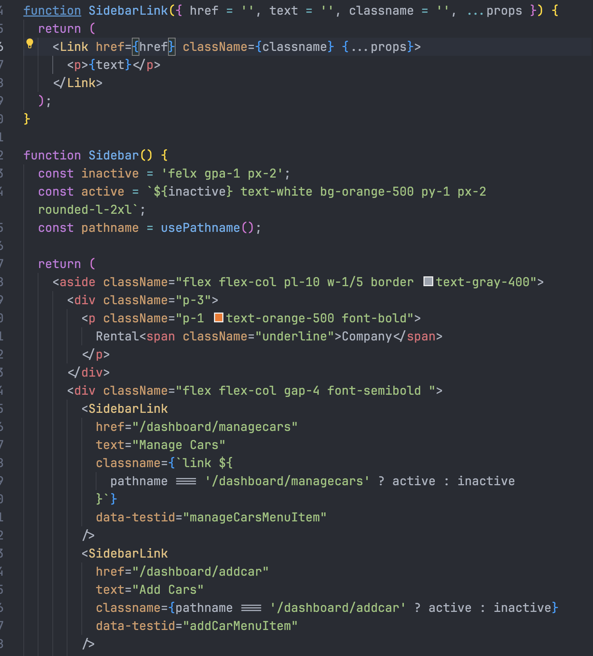
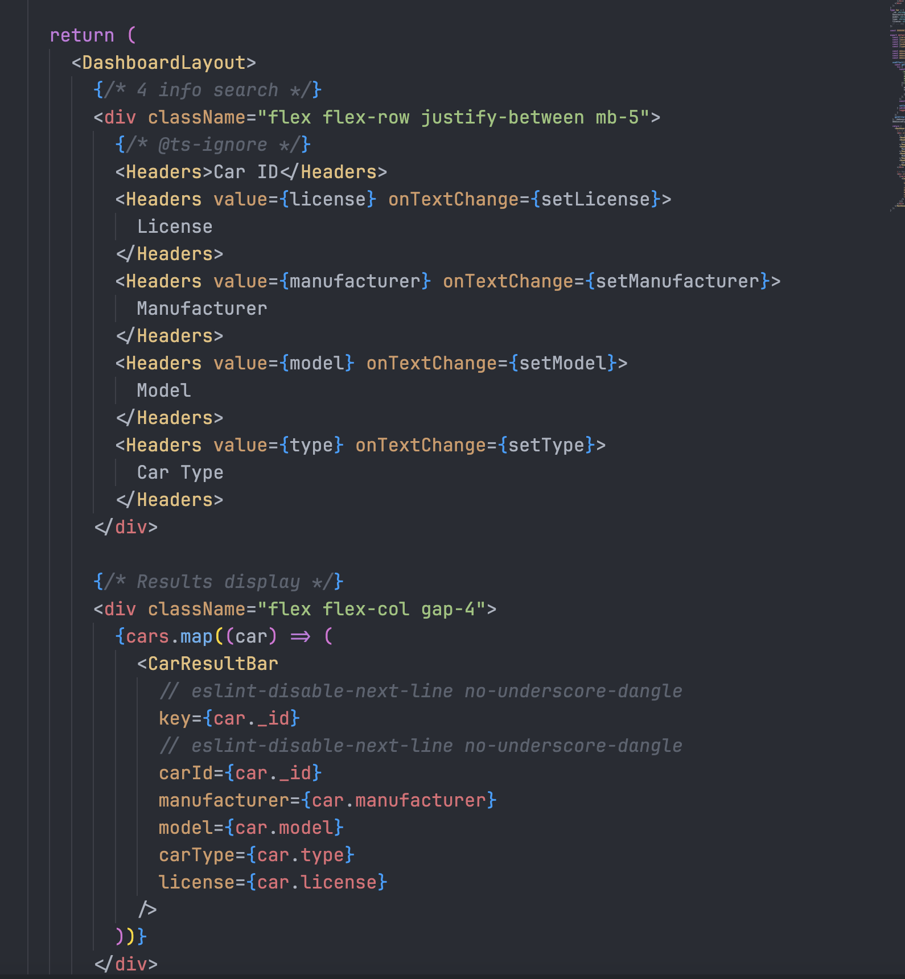
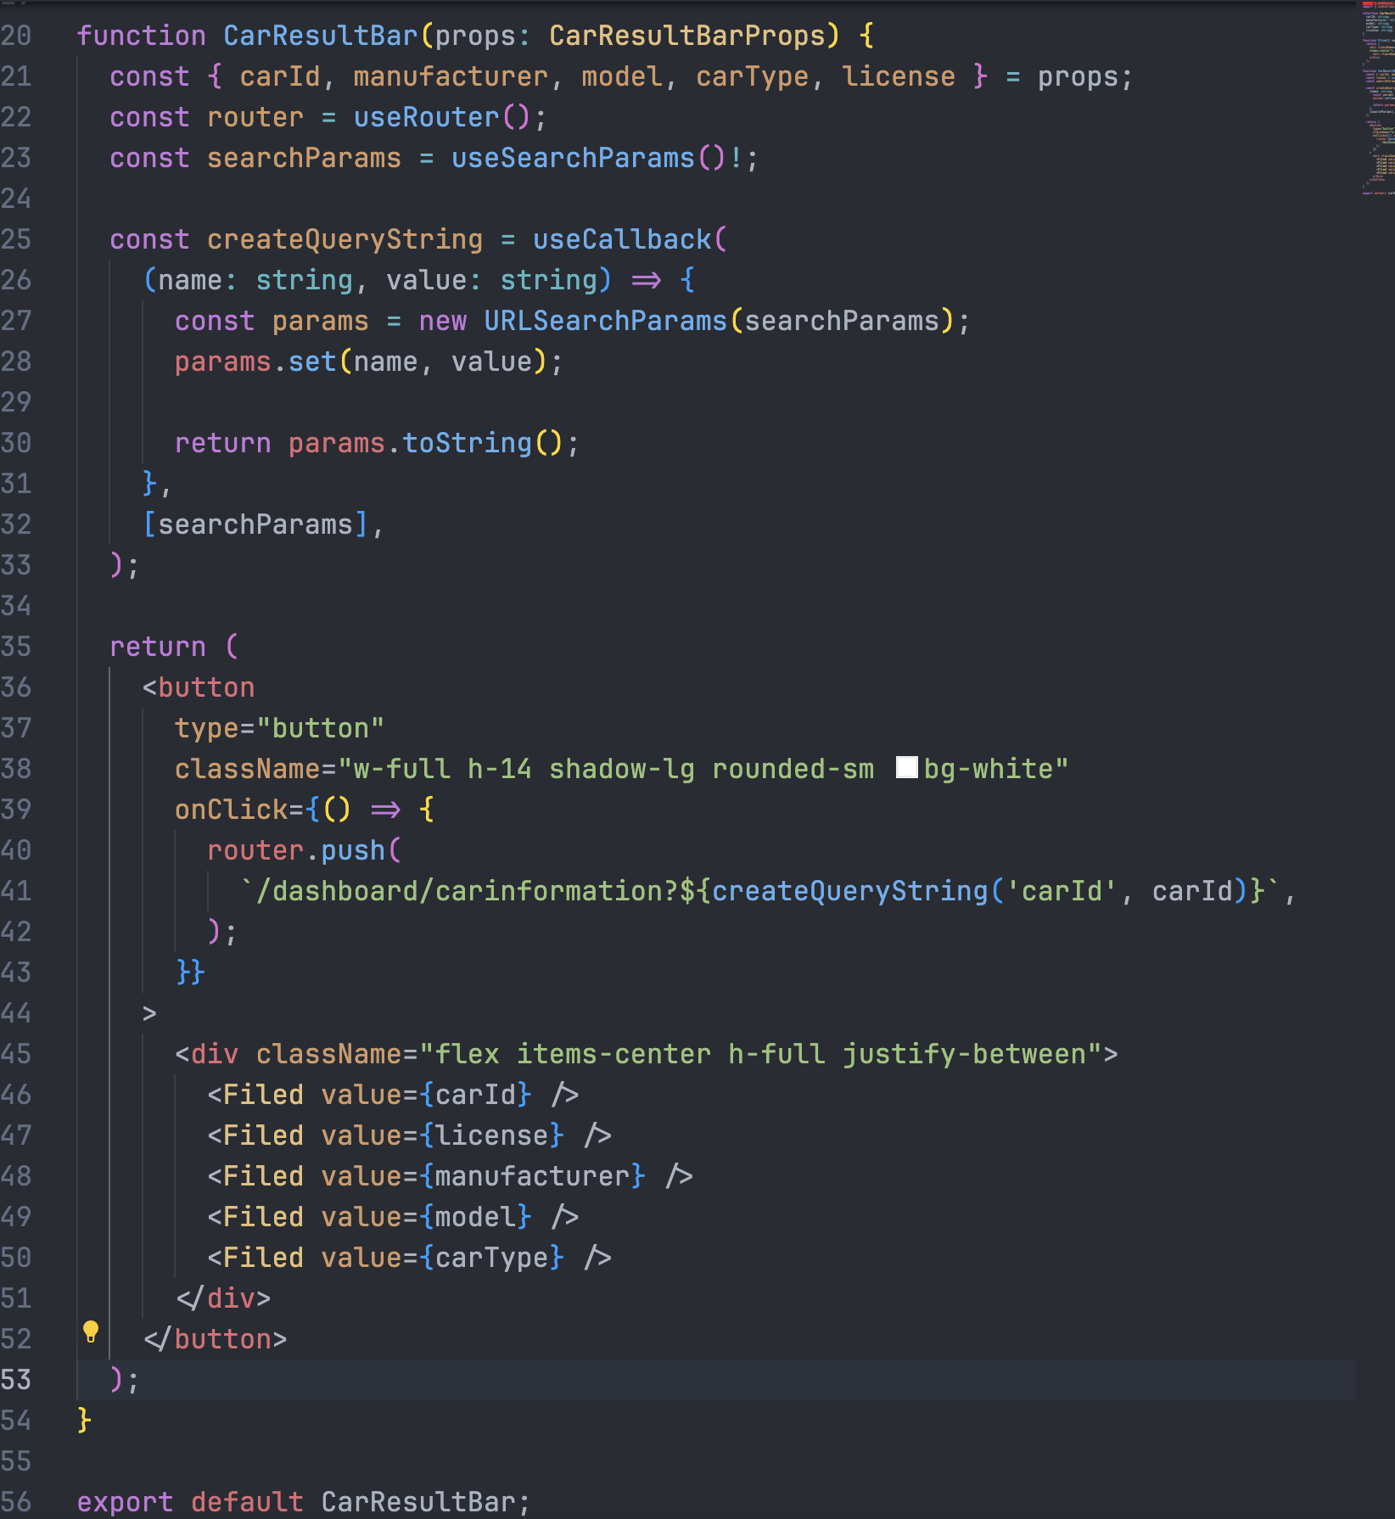

Slide 10
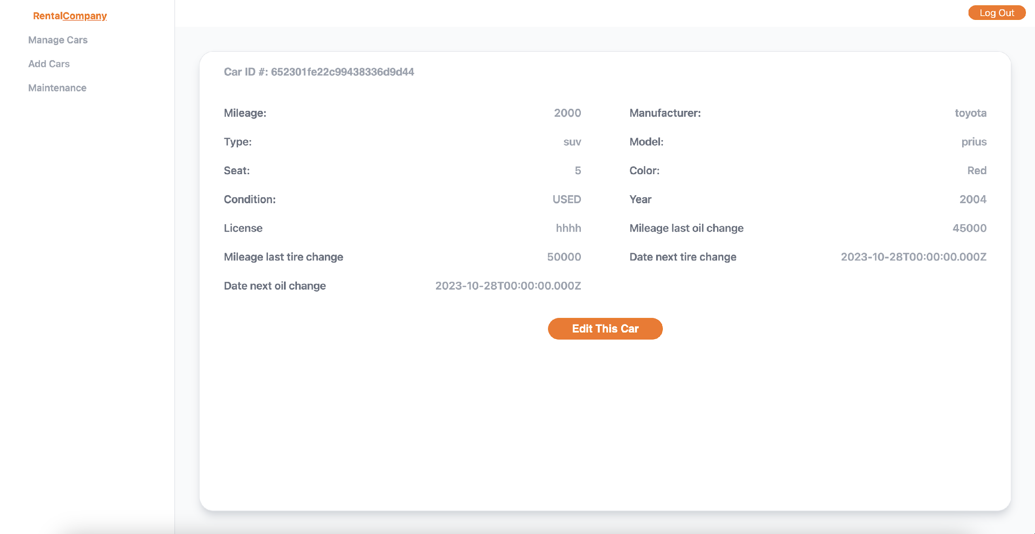
Edit Car by Clicking Car Result

Slide 11
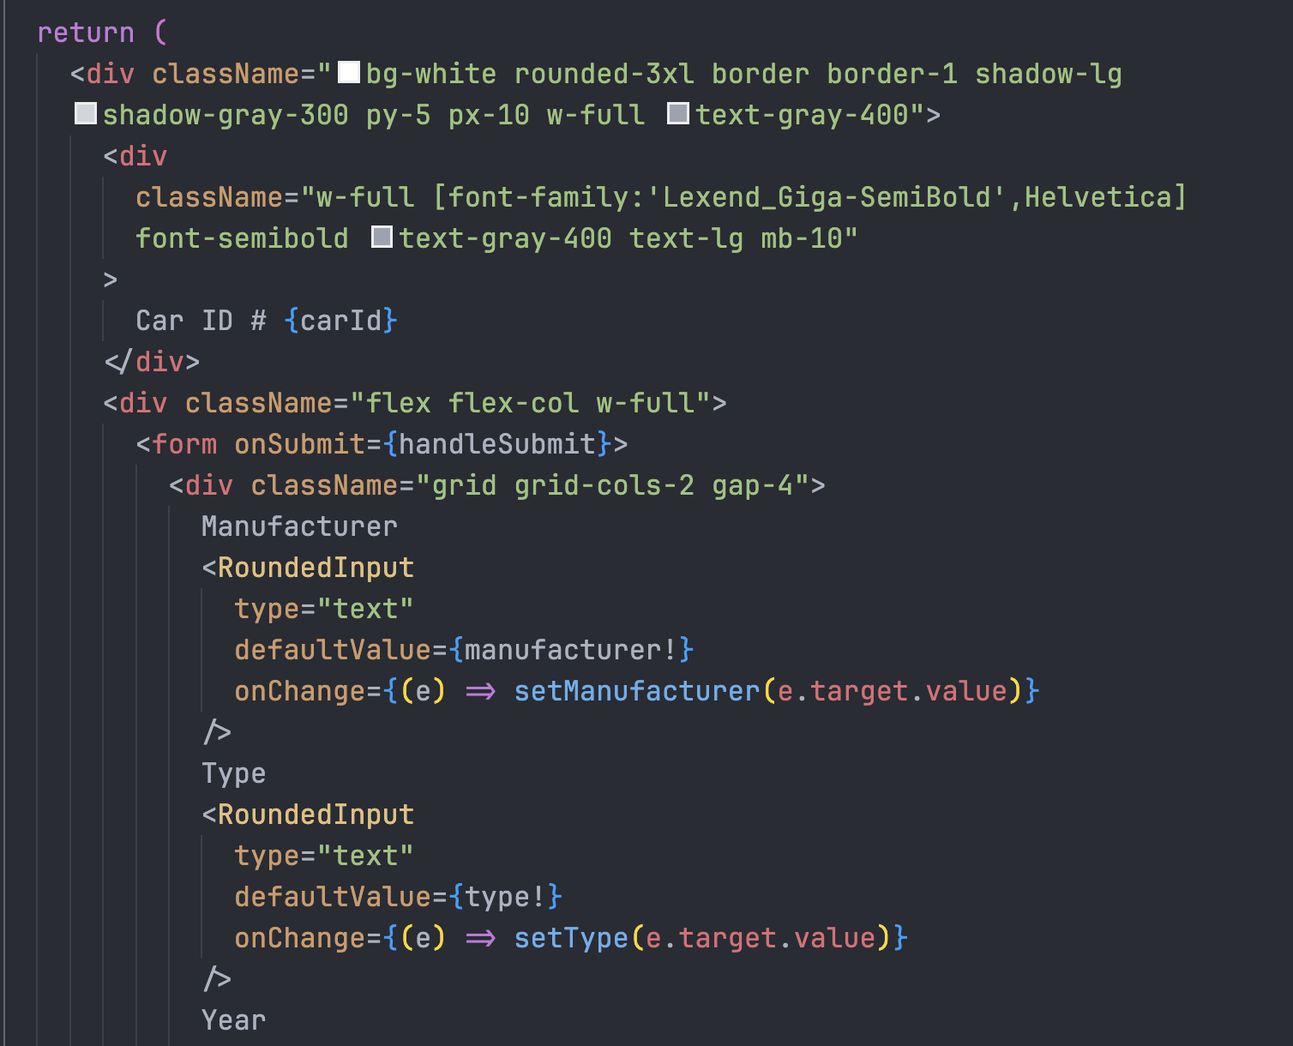
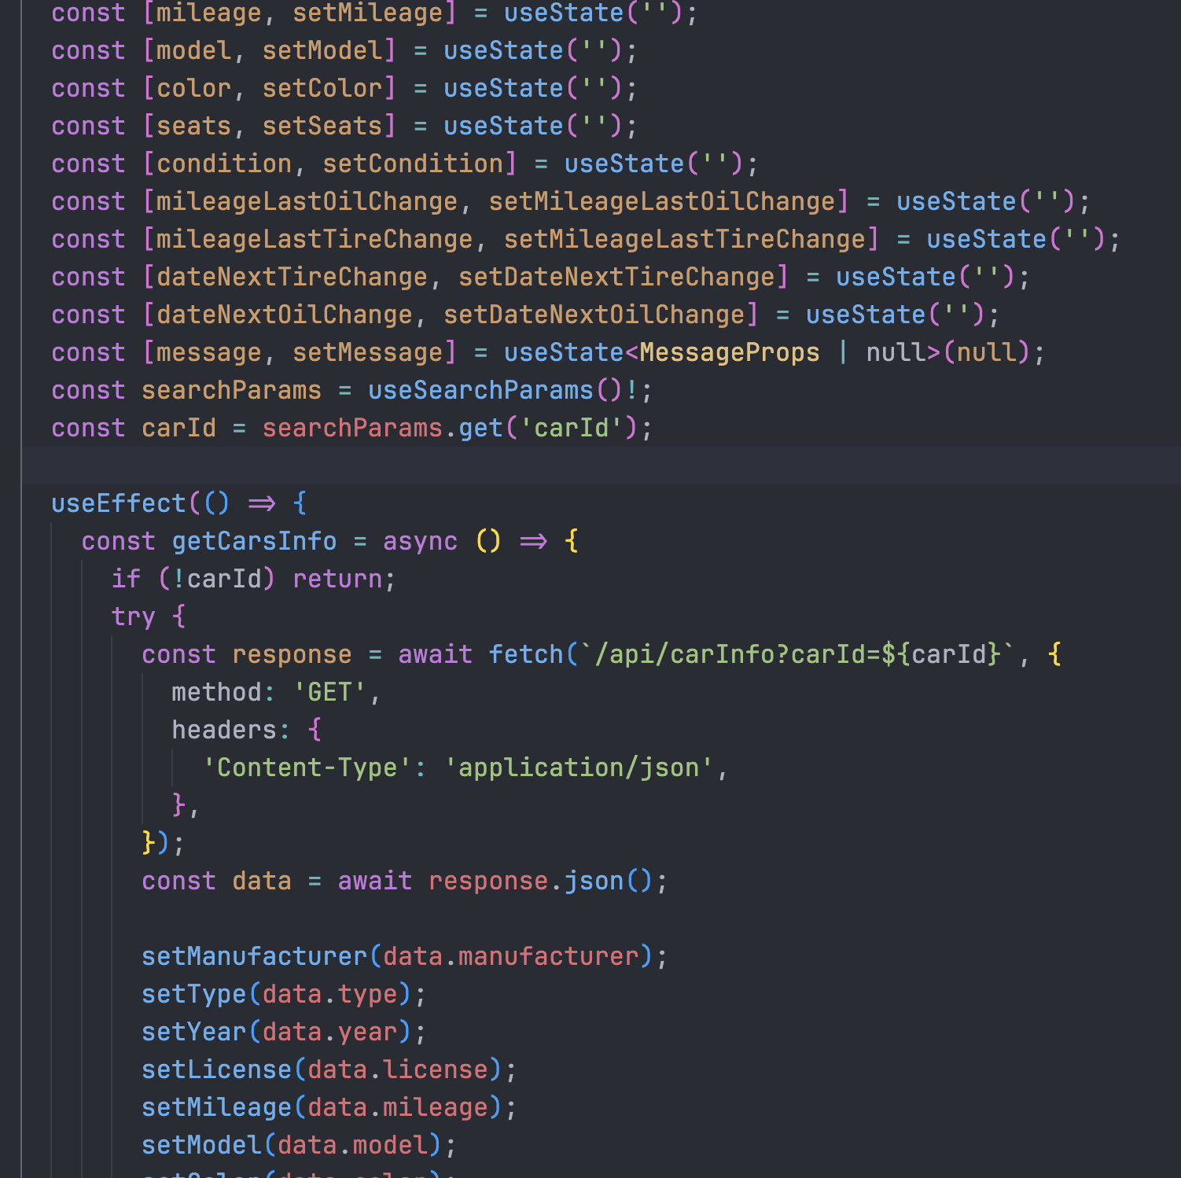
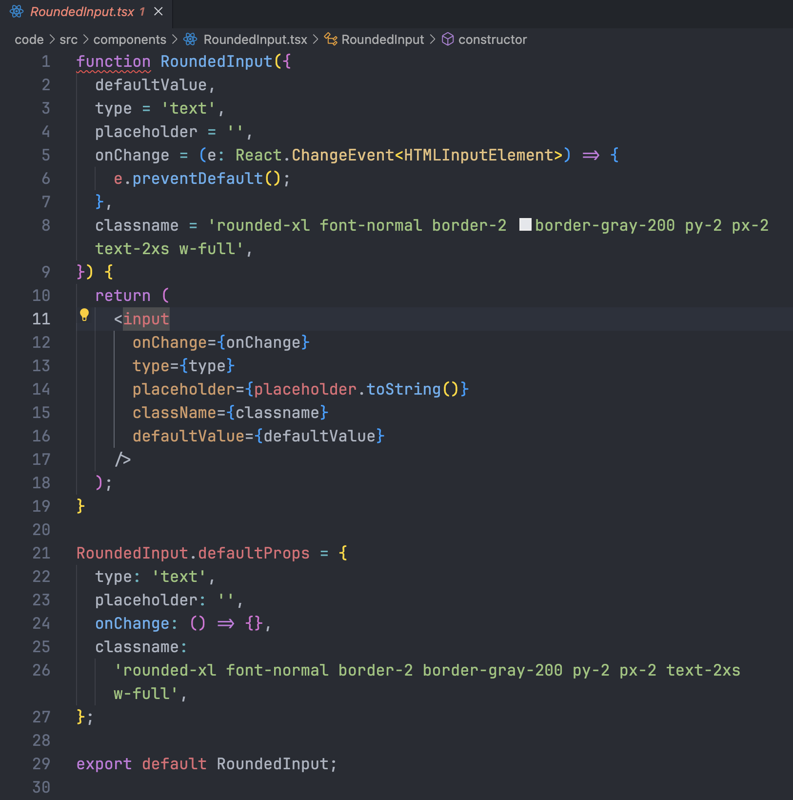

Slide 12
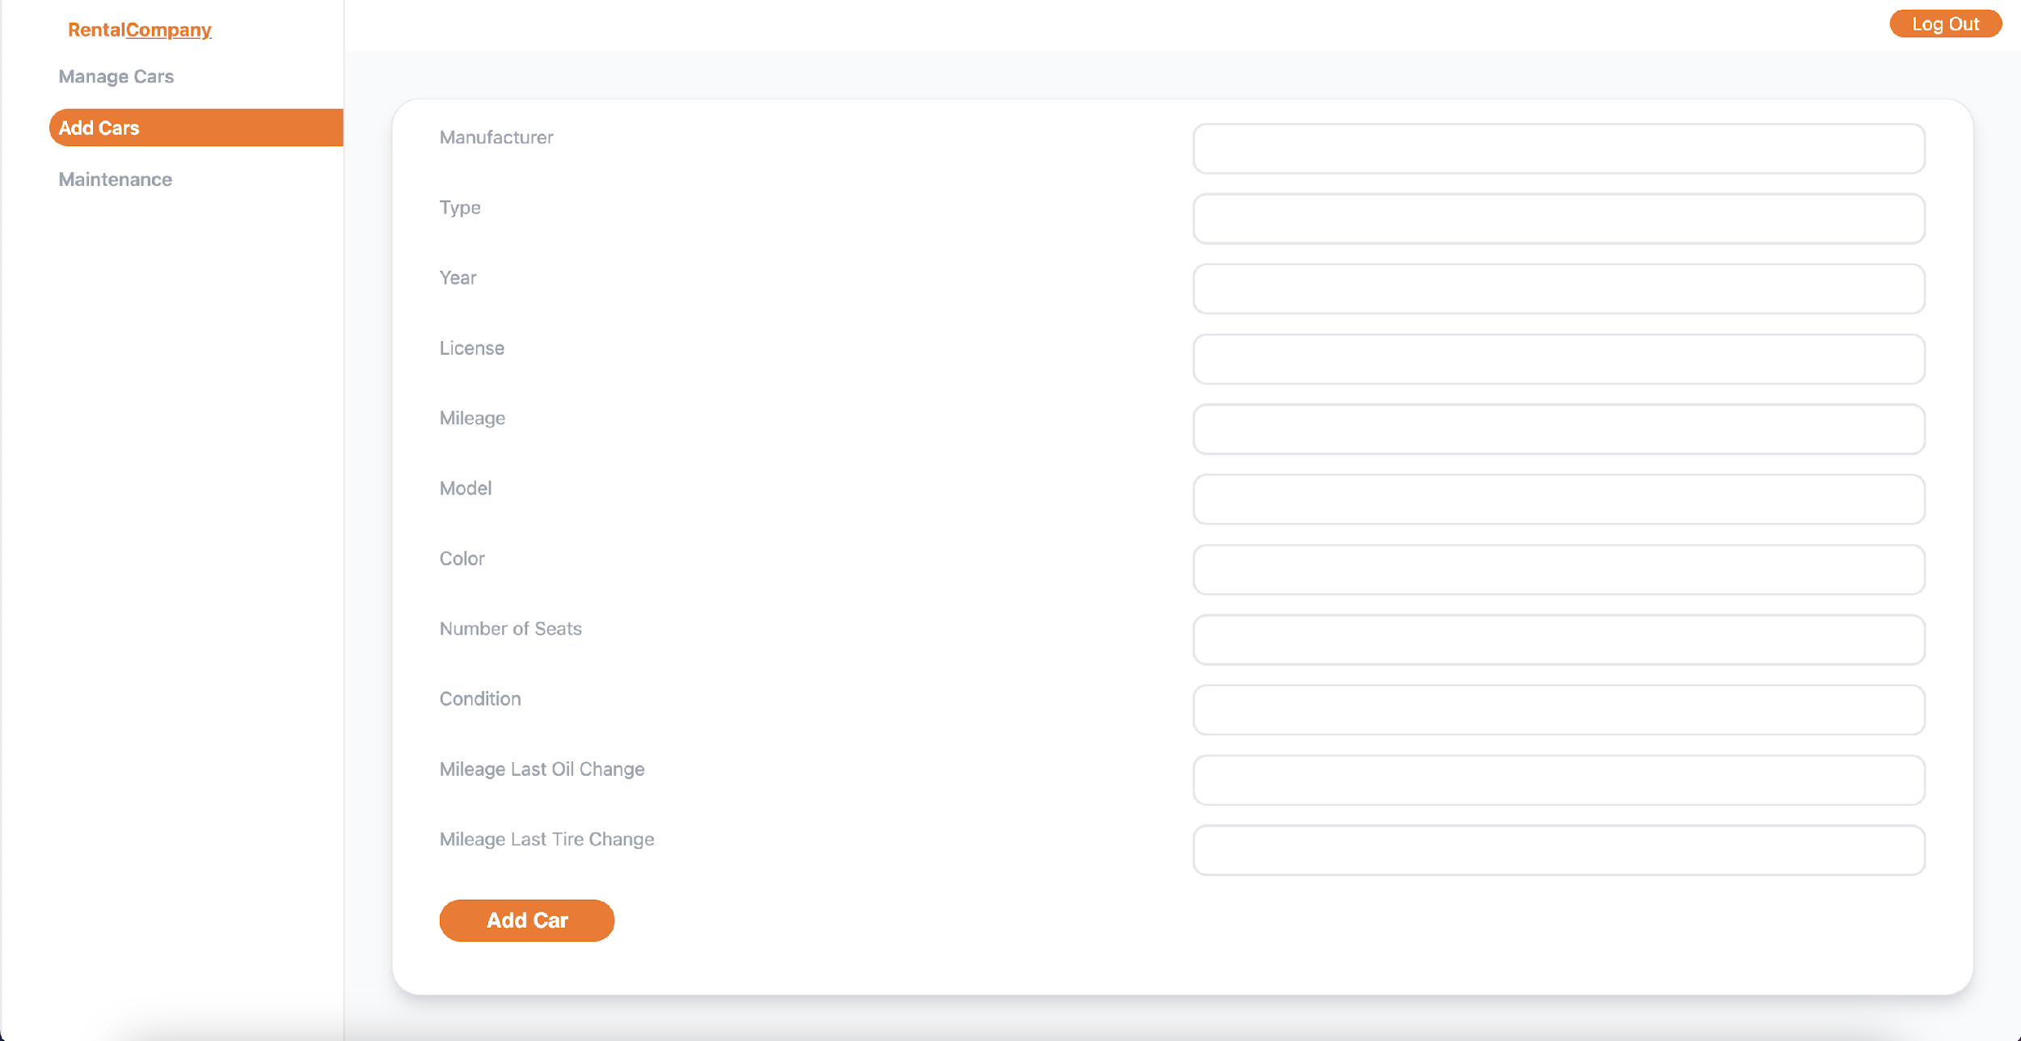
Add Car

Slide 13
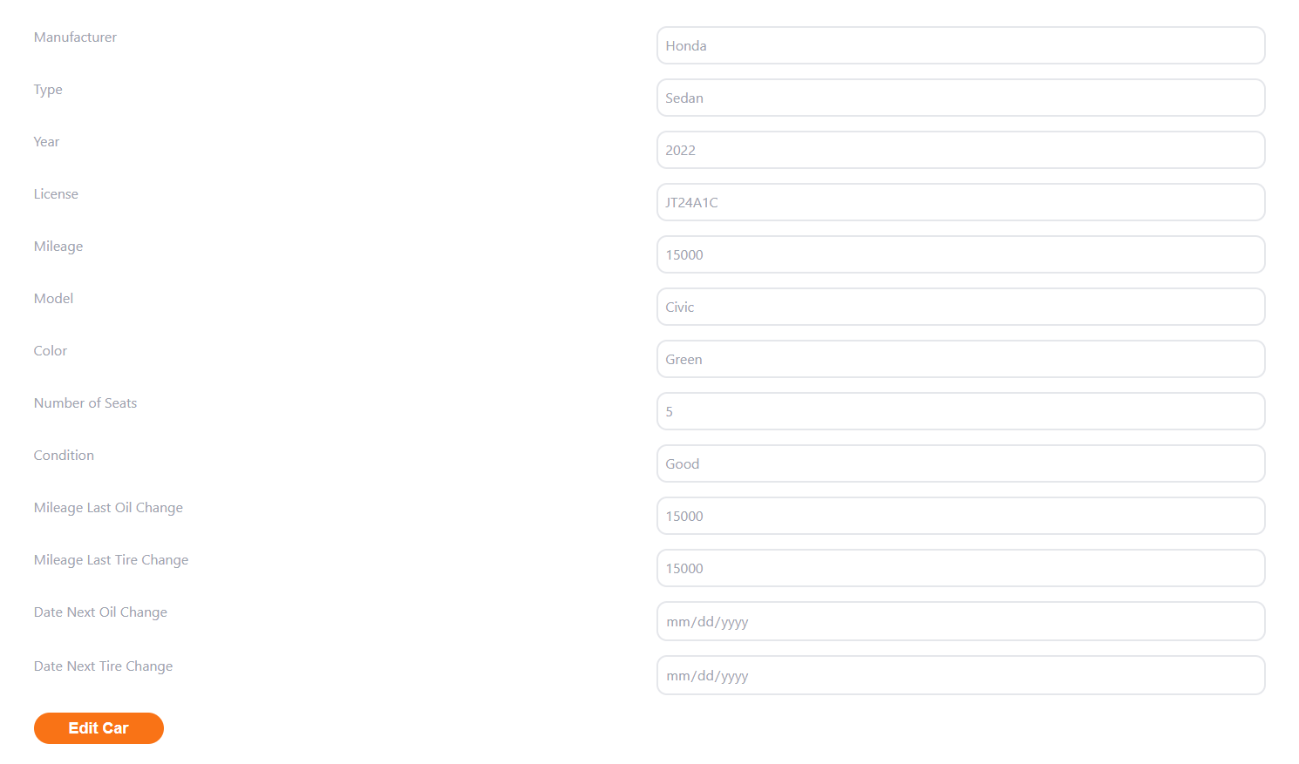

Edit updates

Slide 14
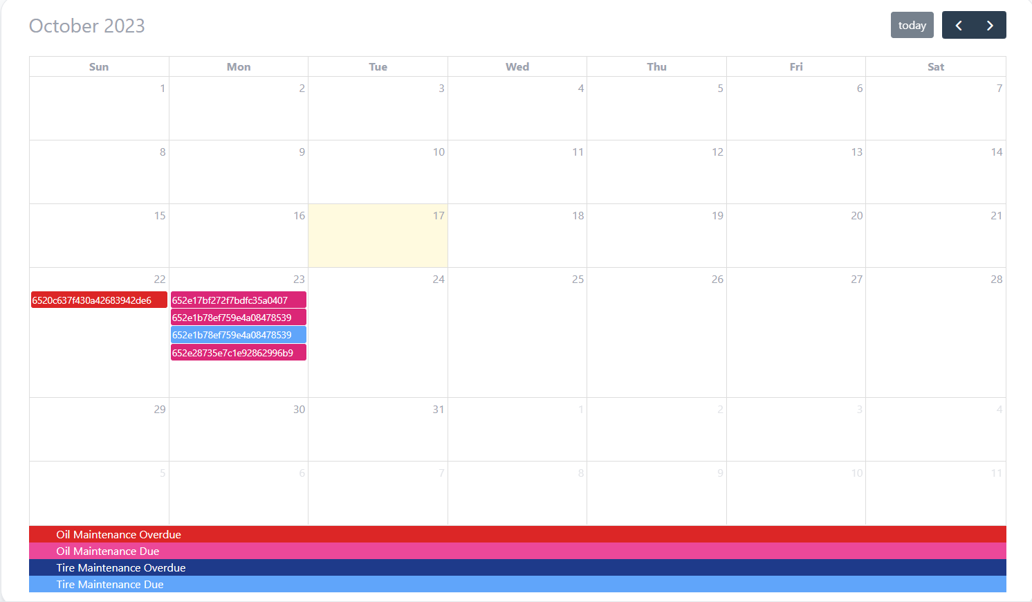
Maintenance
The maintenance information is called to the calendar based on information in the edit page. When mileage is updated, we check if something needs to be handled. If it does, the calendar populates the data necessary.

Slide 15
Requirements
Going into the project we had various requirements to fulfill to make the application work.
Need to be able to manipulate inventory
Adding inventory
Editing inventory
Deleting inventory
Need the information to be helpful and accessible
A tracker for things that need to be accomplished.
Reminders when things are past due
Security for the information
Sign-in/login
Session management

Slide 16

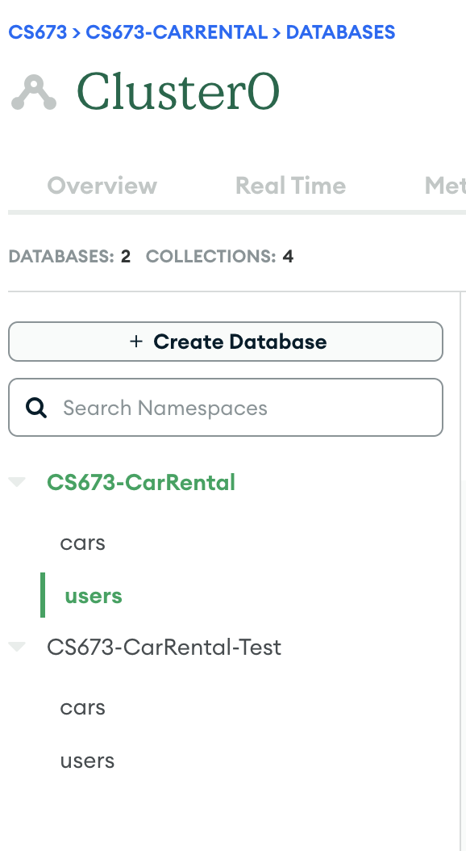
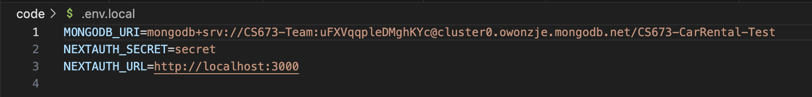
Security
Strong passwords and enable authentication
Hidden verification variable on
Use TLS/SSL to encrypt data transmission
Limited user permissions
Future work:
Backup database
Limited IP address
Security Leader: Cangqing Wang

Slide 17

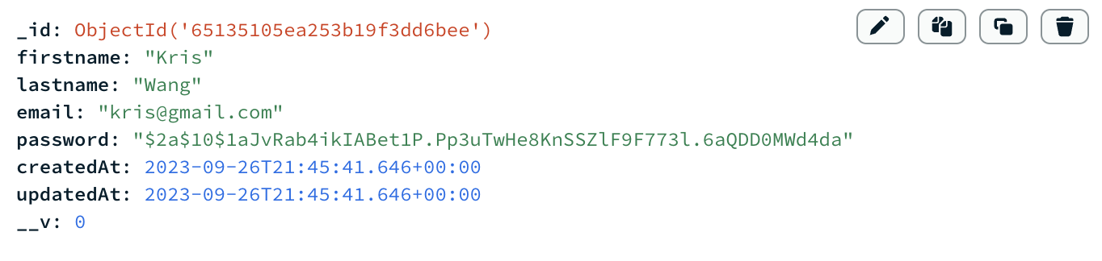
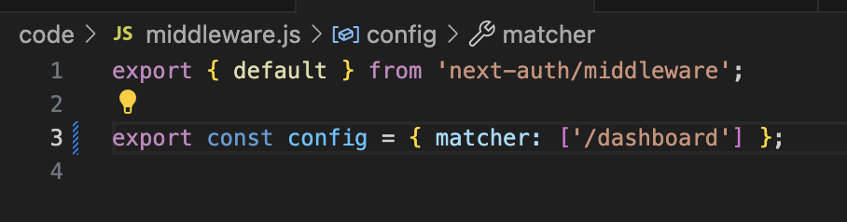
Security
Middleware && User Sign In/Up
CredentialsProvider
SessionStratgy: jwt
Secret: .env file
Use Bcrypt to hash password
bcrypt.compare(password, foundUser.password)

Slide 18
Security
Api endpoint && Logger
Call back token
Get Post Put Delete
Header: application/json
Pino and Logflare

Slide 19

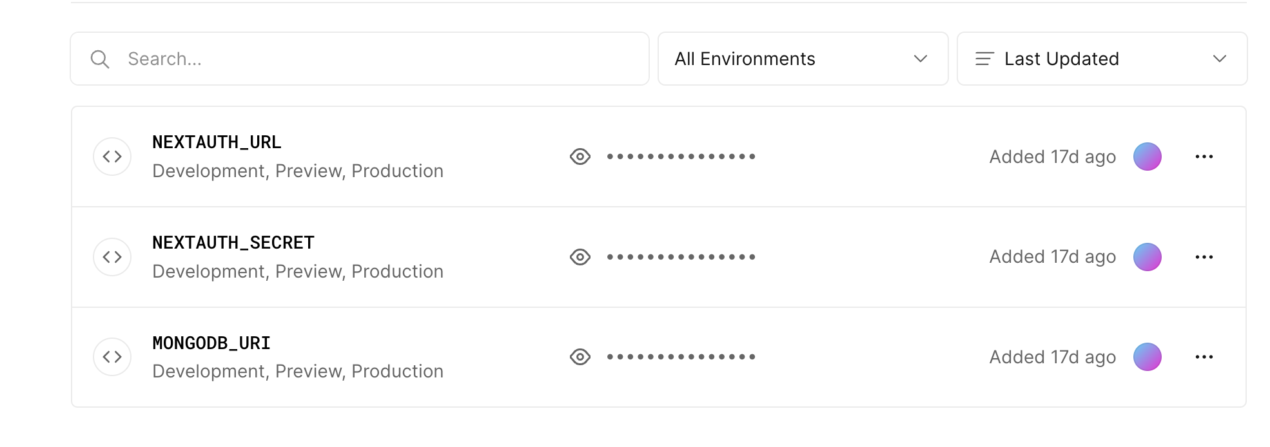
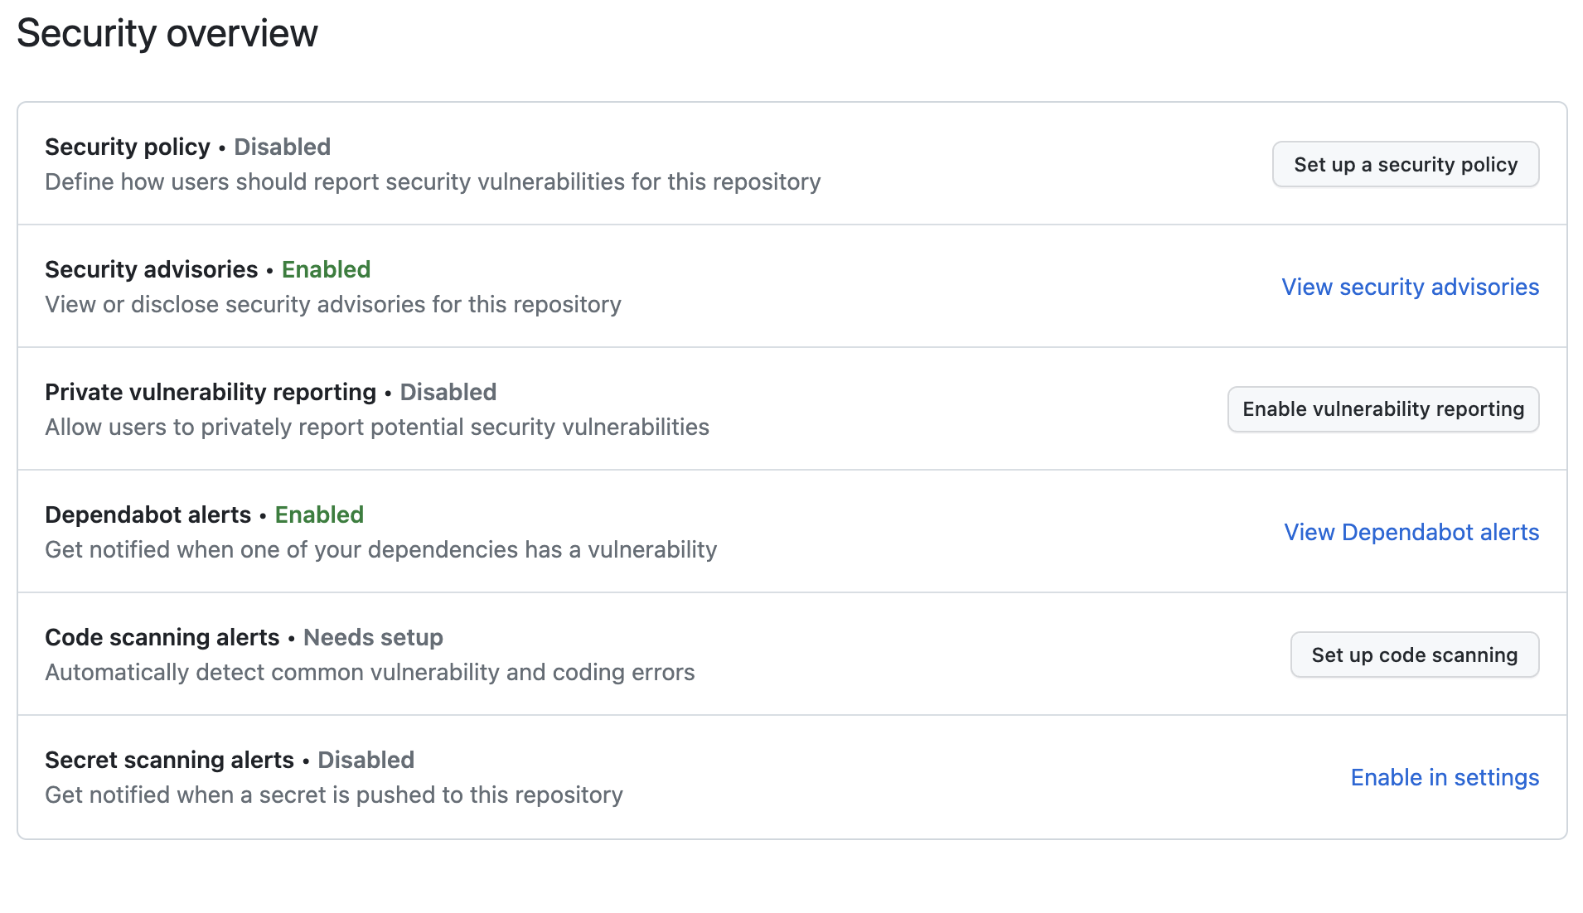
Security
Github Action && Vercel

